Slide 1



Traffic signs recognition
Onisor Ioana, Brici Robert, Oncioiu Costin, Hojda Catalin

Slide 2
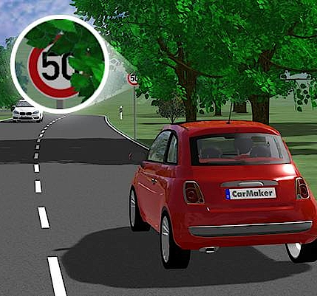
Abstract
In current traffic management systems, there is a high probability that the driver may miss some of the traffic signs on the road because of overcrowding due to neighbouring vehicles. With the continuous growth of vehicle numbers in urban agglomerations around the world, this problem is only expected to grow worse.

Slide 3
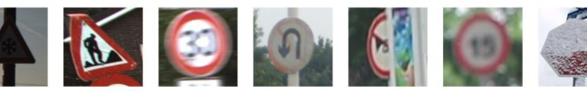
Problem definition
When driving a vehicle, a driver can get different messages according to local road signs. Traffic signs are often designed with eye-catching colors and easy-to-understand symbols. However, if a driver drives in a complex environment or a driver mental state is not well, this might cause the driver to overlook messages from traffic signs.

Slide 4
Finding Training Data
Our first challenge was finding a good training dataset. We picked the Belgian Traffic Sign Dataset because it was big enough to train on, and yet small enough to be easy to work with.
Unique Labels: 62
Total Images: 4575

Slide 5
Minimum Viable Model
We started with the simplest possible model: A one layer network that consists of one neuron per label.
This network has 62 neurons and each neuron takes the RGB values of all pixels as input.
This is a fully-connected layer because every neuron connects to every input value

Slide 6
Building the TensorFlow Graph
TensorFlow encapsulates the architecture of a neural network in an execution graph. The graph consists of operations (Ops for short) such as Add, Multiply, Reshape, …etc. These ops perform actions on data in tensors (multidimensional arrays).

Slide 7

STEPS
The Graph object
Define Placeholders for the images and labels
Define the fully connected layer (ReLU activation function)
Logits vector of length 62
Choosing the right loss function(cross-entropy)
Choosing the optimization algorithm(ADAM optimizer)
Training Loop

Slide 8
Results
To properly measure how the model generalizes to data it hasn’t seen, I do the evaluation on test data that we didn’t use in training. The BelgiumTS dataset makes this easy by providing two separate sets, one for training and one for testing.
The accuracy we get in each run ranges between 0.40 and 0.70

Slide 9
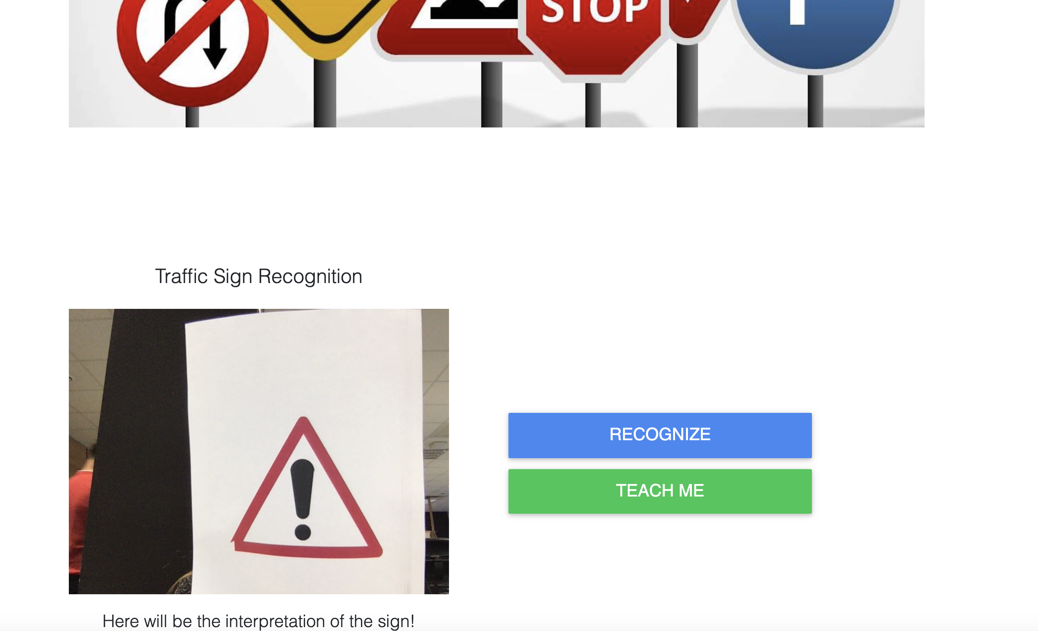
Web application for real-time image classification using on-device camera
Take data and assign it a label to train a custom model and detect new objects
Use your on-device camera to recognize objects using a pre-trained model

Slide 10
Q & A

